Slide 1


PANIMALAR ENGINEERING COLLEGE
DEPARTMENT OF COMPUTER SCIENCE AND ENGINEERING
CS8811 PROJECT WORK
DETECTION OF TUBERCULOSIS USING
IMAGE ENHANCEMENT AND SEGMENTATION
Guide Name:
Thyagarajan C M.E,(Ph.D)
Team Members:
Shravan Karthick K R L [211418104247]
Sree Mithun S A [211418104259]
Surya S [211418104281]

Slide 2
Introduction
Lung cancer is one altogether the foremost common cancers, accounting for over 225,000 cases, 150,000 deaths, and $12 billion in health care costs yearly at intervals the U.S
Stages one and a combine of visit cancers localized to the lungs and latter stages visit cancers that have unfold to different organs. Current diagnostic methods embody biopsies and imaging, like CT scans.
Early detection of cancer significantly improves the chances for survival.
Our task could also be a binary classification draw back to look at the presence of cancer in patient CT scans of lungs with and whereas not early stage cancer.
The ambition is to assemble a CAD arrangement that takes as attribute accommodating chest CT scans and outputs whether or not or not or the accommodating has cancer.

Slide 3
Literature survey
AUTHOR NAME | PAPER NAME | DESCRIPTION
Meet Diwan, Bhargav Patel, Jay Kumar Shah | Classification of Lungs Diseases Using Machine Learning Technique. | In this work, they extract Spectrogram features and labels from lung sound recording to feed into the 2D CNN model from chest X-ray image.
Lokeshwaran V B, Monish Kumar R, Lakshman Raaj S | Tuberculosis diagnosis using Deep Learning. | In this paper, Alex Net Training Model is used for TB detection and various models have also been tested for Classification.
P. A. Kamble, V. V. Anagire, S. N. Chamtagoudar | CXR Tuberculosis Detection using MATLAB Image Processing. | In this paper, Chest X-ray image are pre-processed and then Feature Extracted and SVM classifier is used for Classification.
Ajmal shan C. K., Binoy D. L | An Optimal Way For Tuberculosis Detection. | In this paper, they use Graph Cut Segmentation method and if Tuberculosis is detected they match TB manifestation of both Lungs.

Slide 4
PROBLEM STATEMENT
Chest X-rays (CXR) are used to detect abnormalities. The radiological features show considerable variation, but inmost cases they are characteristic enough to suggest the diagnosis.
The most common features are:
Cavitation
Lymphadenopathy
Patchy, poorly defined segmented consolidation
Miliary tuberculosis
Extension to the pleura, resulting in pleural effusion

Slide 5
DEVELOPMENT ENVIRONMENT
HARDWARE
Intel i5 processor or higher version
8gb Ram
Windows 10 (OS)
Nvidia Graphics Card
SOFWARE
mat lab 2021

Slide 6
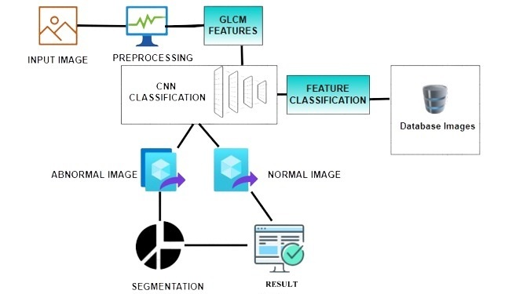
System architecture

Slide 7
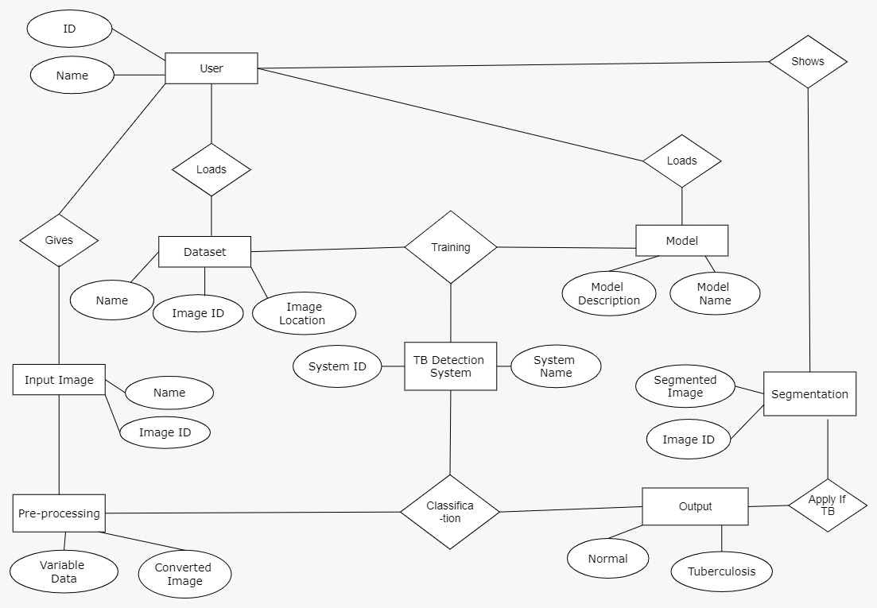
Er diagram

Slide 8
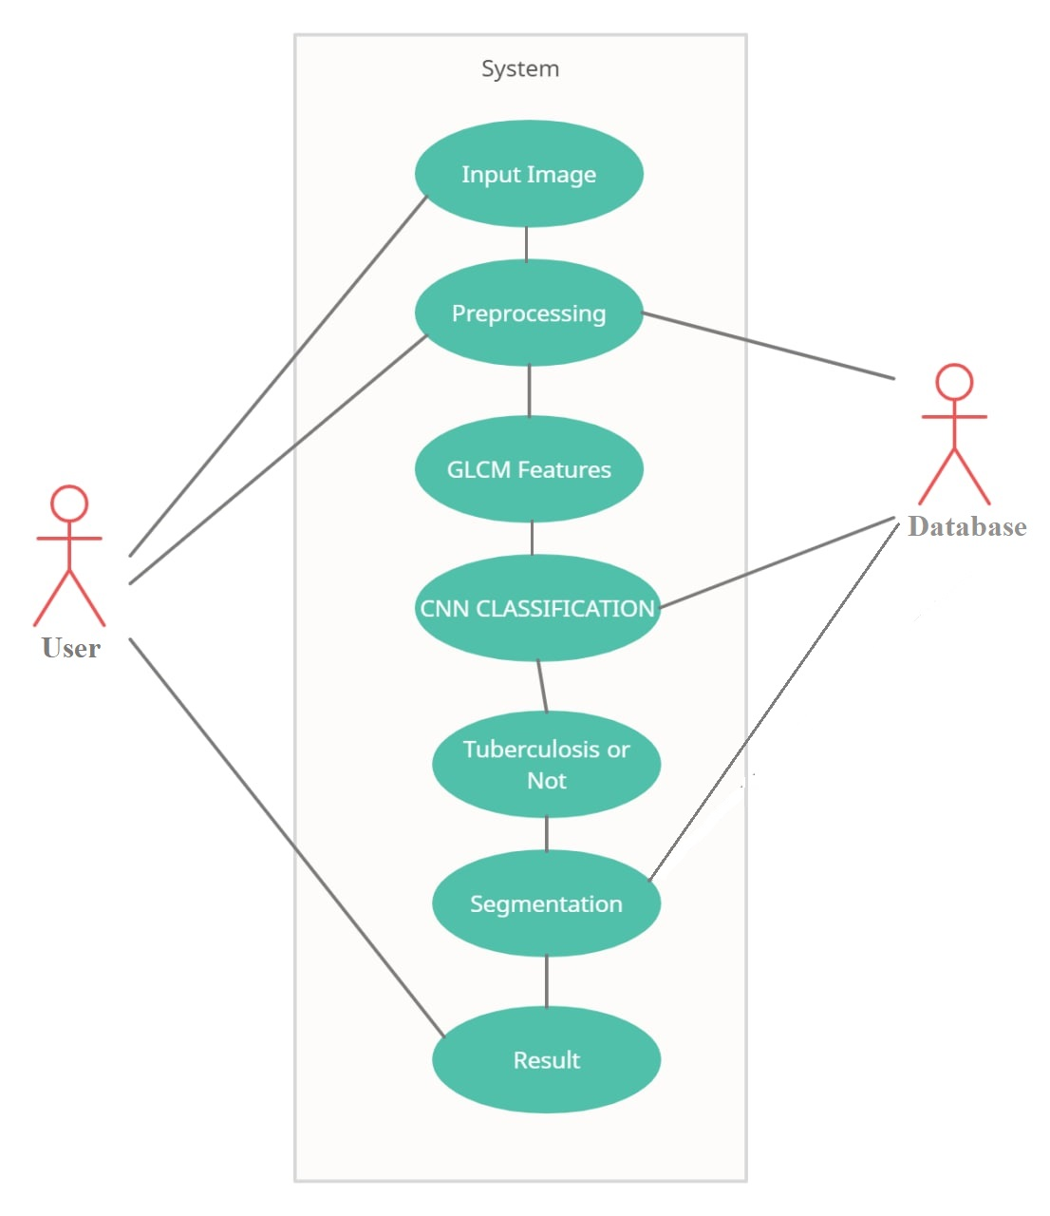
use case diagram

Slide 9
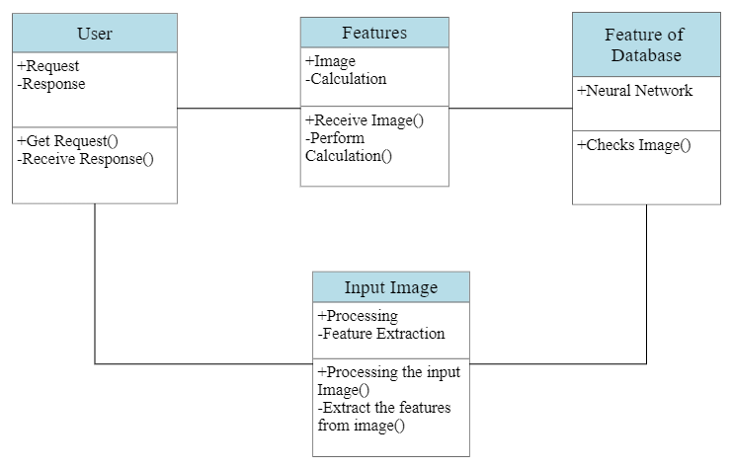
Class diagram

Slide 10
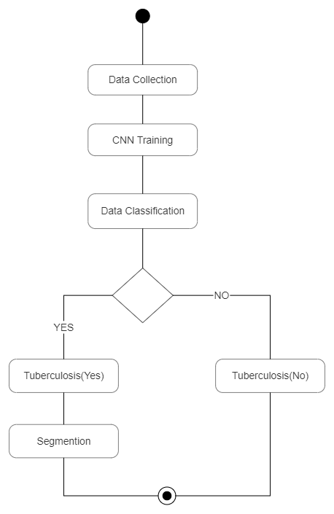
Activity diagram

Slide 11
Module description
Pre-Processing
Pre-Trained Google Net Model
Feature Extraction
CNN Neural Network
Segmentation
Transfer Learning

Slide 12
Pre-processing
The aim of pre-processing is an improvement of the image data that reduces unwanted distortions or enhances some image features important for further processing.
In this we are performing three processes they are:
1. Resize
2.Conversion
3. Filtering (Median)

Slide 13
PRE-TRAINED GOOGLE NET MODEL
Google net pre-trained CNN model is selected as the feature extractor in this proposed system.
Google net has been trained on more than a million images from the ImageNet database and it can classify images into 1000 object categories with about 60 million parameters.
The architecture of Google net consists of eight learned layers, five convolution layers followed by three fully connected layers.
In MATLAB platform, Google net architecture consists of 26 layers: The first 23 layers are for feature extraction, whereas the last three layers are for classifying these features into 1000 classes.

Slide 14
Feature extraction
The process of collecting higher-level information of an image such as shape, texture, colour, and contrast.
Texture analysis is an important parameter of human visual perception.
It is used effectively to improve the accuracy of diagnosis system by selecting prominent features.

Slide 15
CNN Neural network
Neural networks are computing systems with interconnected nodes that work much like neurons in the human brain.
Using algorithms, they can recognize hidden patterns and correlations in raw data, cluster and classify it, and – over time – continuously learn and improve.
Using neural network we train our database and from that it will classify our data, then input image is matched with our data based on it it will decide input is infected or not.

Slide 16
segmentation
Segmentation is to simplify and change the representation of an image into something that is more meaningful and easier to analyze.
To extract the features of the tissues to satisfy the segmented parts first the non-specific parts are removed that are not parts of the pneumonia region.
After that the filtering process is applied to eliminate the noise from the x-ray images.

Slide 17
Transfer learning
Transfer learning is commonly used in deep learning applications. You can take a pre trained network and use it as a starting point to learn a new task.
Fine-tuning a network with transfer learning is usually much faster and easier than training a network with randomly initialized weights from scratch.
In this project quickly transfer learned features to a new task using a smaller number of training images.

Slide 18
RESULT
In this project presents experimental results and discuss the suitability of the best performing representation and model over the others.
The architecture of trained model is based on the tuberculosis classification of CNN with two samples of tuberculosis and also used on chest images.
After the 10 epochs our results contains 100% accuracy on both figure 5.1 and 5.2. In this figure 5.1 sample image of tuberculosis and normal classification from the Google net model.
In the figure 5.2 contains classification using the pre trained model. In figure 5.3 and 5.4 represents the output of one of the sample images.

Slide 19
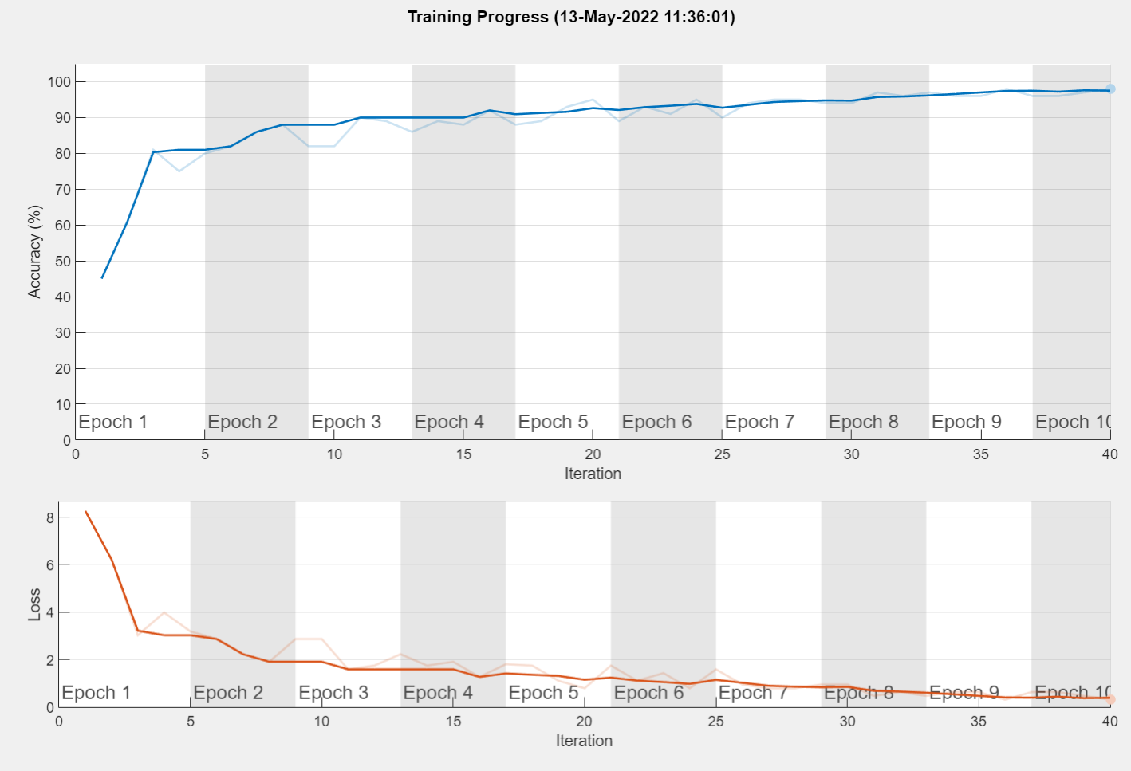
Fig 5.1. Accuracy on training window

Slide 20
Fig 5.2 Screenshot for displaying accuracy rate and loss rate

Slide 21
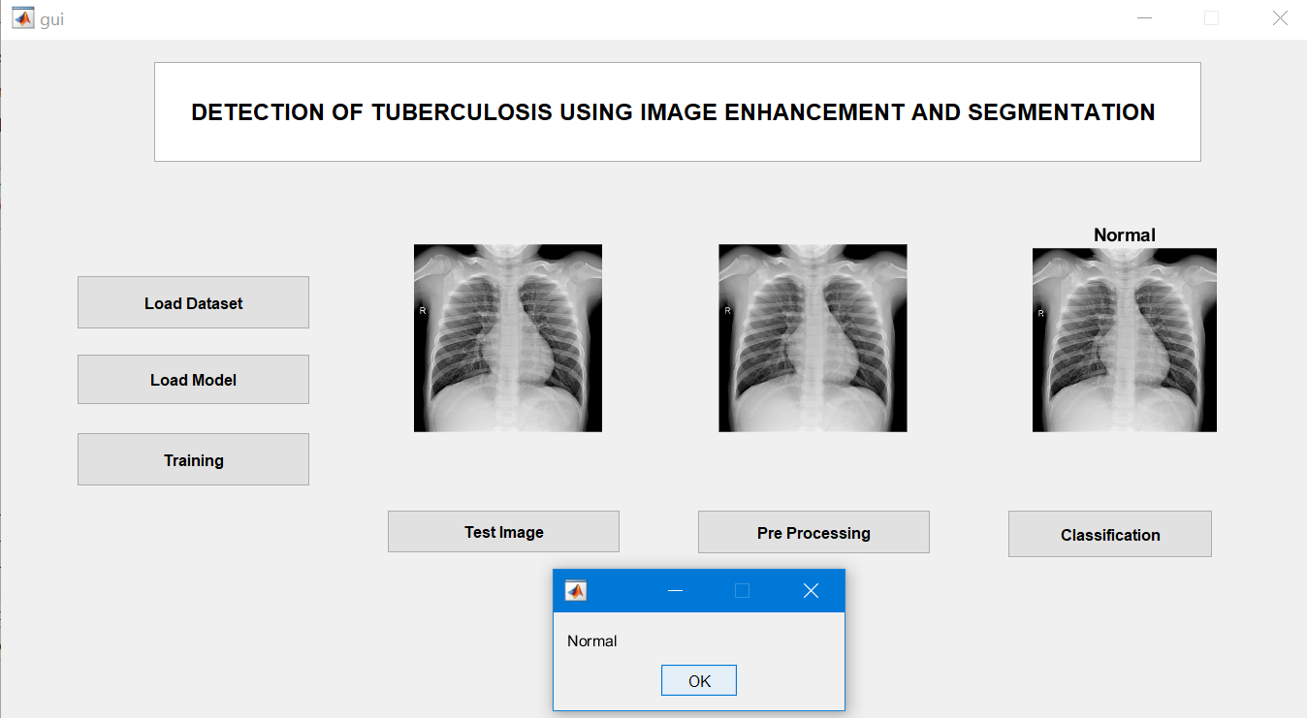
Fig 5.3. Result of normal Condition Classification

Slide 22
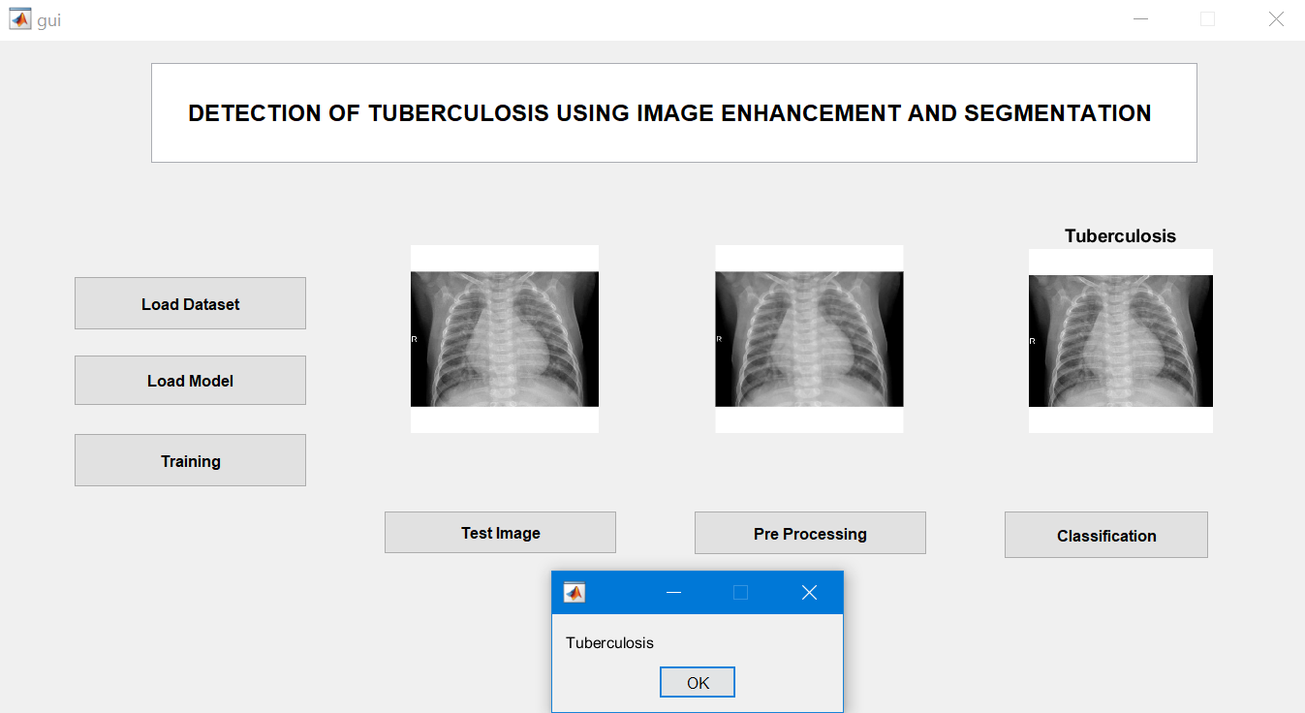
Fig 5.4. Result of Tuberculosis Condition Classification

Slide 23
CONCLUSION
In this project, transfer learning method used for X Ray tuberculosis classification on normal and abnormal detection. X Ray dataset was taken from the Kaggle Dataset for normal and abnormal tuberculosis.
Different methodologies proposed by various researchers are considered, all of which show that image processing had a major role in chest detection, but no one touches tuberculosis classification.
From the performance criteria such as accuracy, loss and this method had been recommended to increase the prognosis.
Diagnosing tuberculosis abnormalities was a complex and sensitive task to preciseness, reliability. Experiments shows the effectiveness of data augmentation, especially in the case of insufficient training data.

Slide 24
reference
[1] An Optimal Way For Tuberculosis Detection Ajmal shan C. K.1, Binoy D. L.2 International Research Journal of Engineering and Technology (IRJET) e-ISSN: 2395 -0056 Volume: 03 Issue: 07 | July-2016 www.irjet.net p-ISSN: 2395-0072.
[2] Classification of Lungs Diseases Using Machine Learning Technique Meet Diwan1, Bhargav Patel2, Jaykumar Shah3 International Research Journal of Engineering and Technology (IRJET) e-ISSN: 2395-0056 Volume: 08 Issue: 09 | Sep 2021 www.irjet.net p-ISSN: 2395-0072.
[3] Tuberculosis diagnosis using Deep Learning Lokeshwaran V B1, Monish Kumar R2, Lakshman Raaj S3 International Research Journal of Engineering and Technology (IRJET) e-ISSN: 2395-0056 Volume: 08 Issue: 07 | July 2021 www.irjet.net p-ISSN: 2395-0072.
[4] CXR Tuberculosis Detection Using MATLAB Image Processing Mr. P. A. Kamble1, Mr. V. V. Anagire2, Mr. S. N. Chamtagoudar3 International Research Journal of Engineering and Technology (IRJET) e-ISSN: 2395 -0056 Volume: 03 Issue: 06 | June-2016 www.irjet.net p-ISSN: 2395-0072.

Slide 25
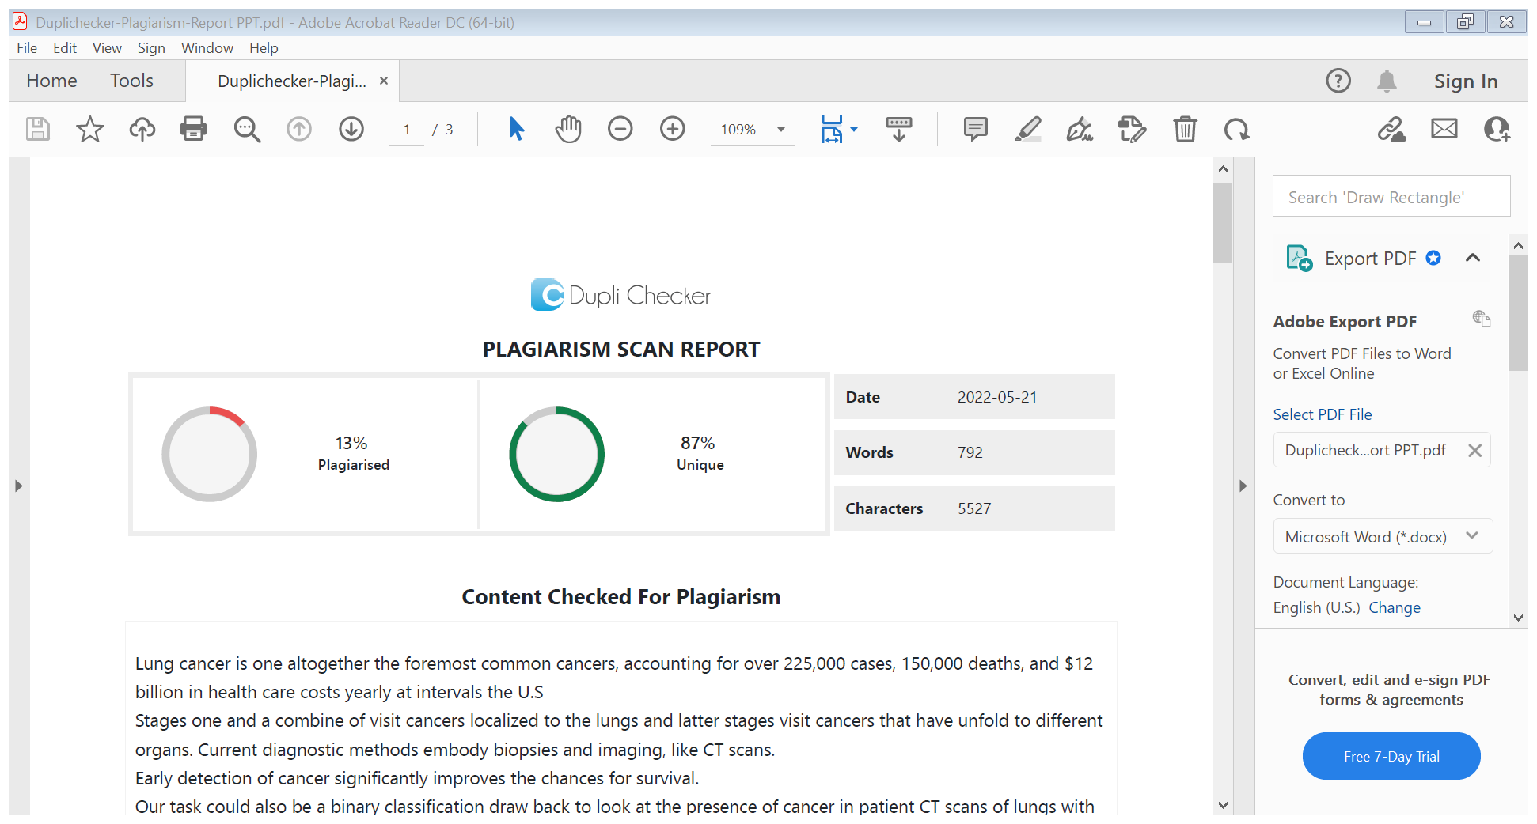
Plagiarism report

